Slide 1
Design and integration of project-specific ontology for data analytics support
Miloš Šipetić, Reinhard Jentsch, Judit Aizpuru, Jan Kurzidim
Austrian institute of technology
Linked data in architecture and construction 2020

Slide 2
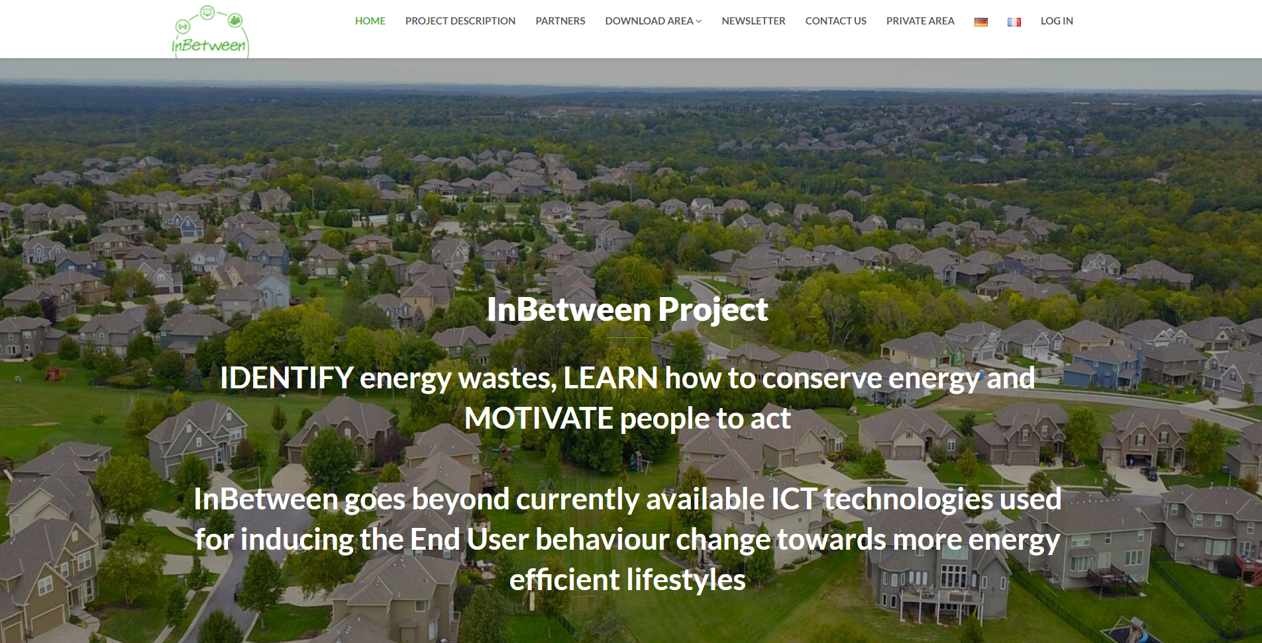
Inbetween project
H2020 project
Grant Agreement number: 768776
https://www.inbetween-project.eu/
2018-2020
Co-funded by the Horizon 2020 programme of the European Union

Slide 3
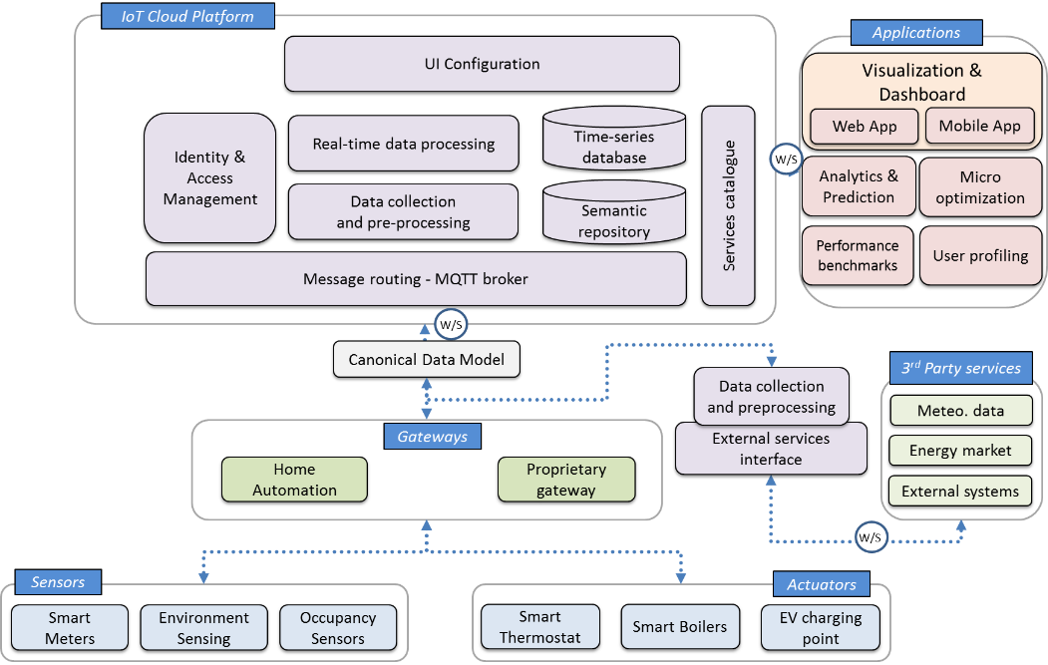
System architecture

Slide 4
Motivation for the ontology
Different demonstration sites
Different technologies used
Different kinds of third-party data (sources external to the project)
Time series metadata
Development of (semi-)automated commissioning procedure
Development of generalized analytics pipelines
Usage of collected data by multiple stakeholders

Slide 5
Data needs
List of all the intended energy actions and analyses
Lists of:
time series
Metadata
Other data
E.g. Detecting energy waste (any kind of heating device turned on while temperature within normal bounds)
Temperature measurements from rooms
Heating bodies consumption or on/off information per room
Size of apartment
Usual number of occupants…

Slide 6
Identified important concepts
Sensors
Actuators
Meters
Spaces
Site/dwelling description + topology
Monitoring time series description
Third party data (weather data, weather forecasts)
ML results (prediction models+descriptions)

Slide 7
Ontologies to reuse
Analysis of existing ontologies
Identification of most promising for reuse based on
Domain coverage
Level of (community) support
Research interest
BOT
SAREF
SAREF4BLDG

Slide 8
Imports graph
SAREF
TIME
* SAREF
Alignment module
INBETWEEN
BOT
* SAREF4BLDG
Alignment module
SAREF4BLDG
* G.F. Schneider - Towards aligning domain ontologies with the building topology ontology

Slide 9
Time series related classes

Slide 10
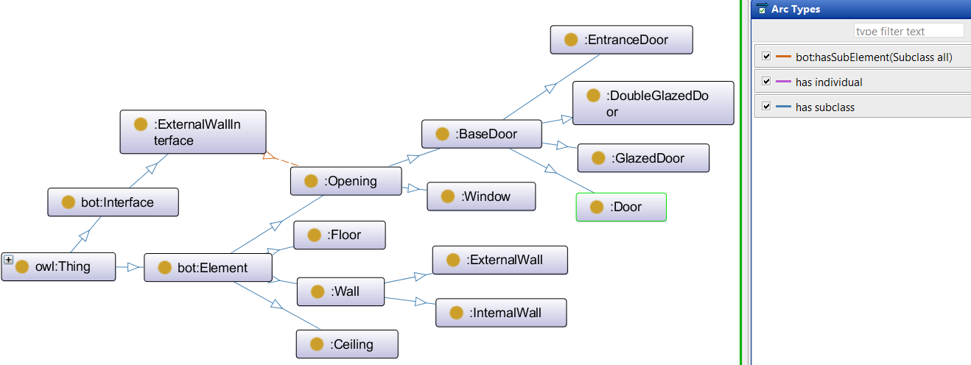
Building elements specializations

Slide 11
Space usage

Slide 12
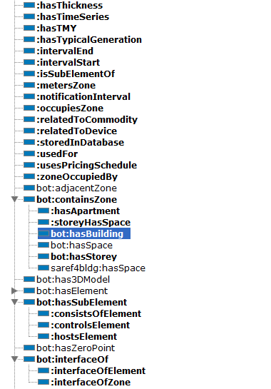
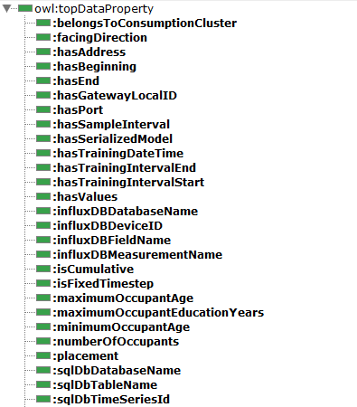
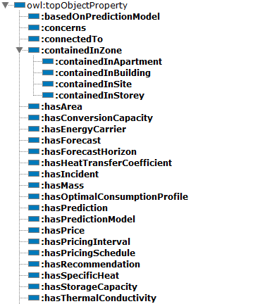
Additional data and object properties

Slide 13
Data collection and integration
Demonstration site survey
Transformation into triplets
Usage
Third-party data
Occupant questionnaires
Device ids
Setup of transformation rules
Site plans
Description of data points
Linking to time series storage
Commissioning data collection
Locations
Links to monitoring data storage
Transformation into table format
Transformation of the collected dataset

Slide 14
Cellfie

Slide 15
Use cases

Slide 16
Virtual occupancy sensor – Motivation
Direct occupancy detection methods are
Expensive
Privacy invading
imprecise
Usually based on
Cameras
Person counting
Motion sensors with time threshold
For specific residential scenarios useful to have occupancy information
With additional information it is possible to use motion sensors to infer occupancy

Slide 17
Virtual occupancy sensor – solution
Interpret contextual data to infer occupancy
Dwelling entrance door status
Motion sensor data
Need to know:
topology in very rough outlines
Time series references

Slide 18
Virtual occupancy sensor – state change diagram
Motion
Timeout
Timeout
Door opened
Door closed
Motion
Motion
Door
opened
No
occupancy
Open
Closed
(transition)
Occupancy
Timeout
Motion
Door opened
Timeout
Door opened
Door closed
Timeout
Motion

Slide 19
Virtual occupancy sensor - queries
SELECT ?apartment ?timeseries_ref WHERE {
?apartment a inbetween:Apartment.
?apartment bot:containsZone ?space.
?space bot:adjacentElement ?wall.
?wall a inbetween:InternalWall.
?wall inbetween:hostsElement ?door.
?door inbetween:hostsElement ?sensor.
?sensor bot:hasSubElement ?doorsens.
?doorsens a inbetween:DoorWindowSensor.
?doorsens inbetween:hasTimeSeries ?timeseries_ref
}
:InfluxDbTimeSeries
bot:adjacentElement
:hasTimeSeries
:hostsElement
bot:hasSubelement
:DoorWindowSensor
:DoorSensor
:EntranceDoor
bot:Space
:InternalWall
:Apartment
:hostsElement
bot:containsZone

Slide 20
Virtual occupancy sensor - queries
SELECT ?apartment ?sensor ?timeseries_ref WHERE {
?apartment a inbetween:Apartment.
?apartment bot:containsElement ?sensor.
?sensor bot:hasSubElement ?motionsensor.
?motionsensor a inbetween:MotionSensor.
?motionsensor inbetween:hasTimeSeries ?timeseries_ref
}

Slide 21
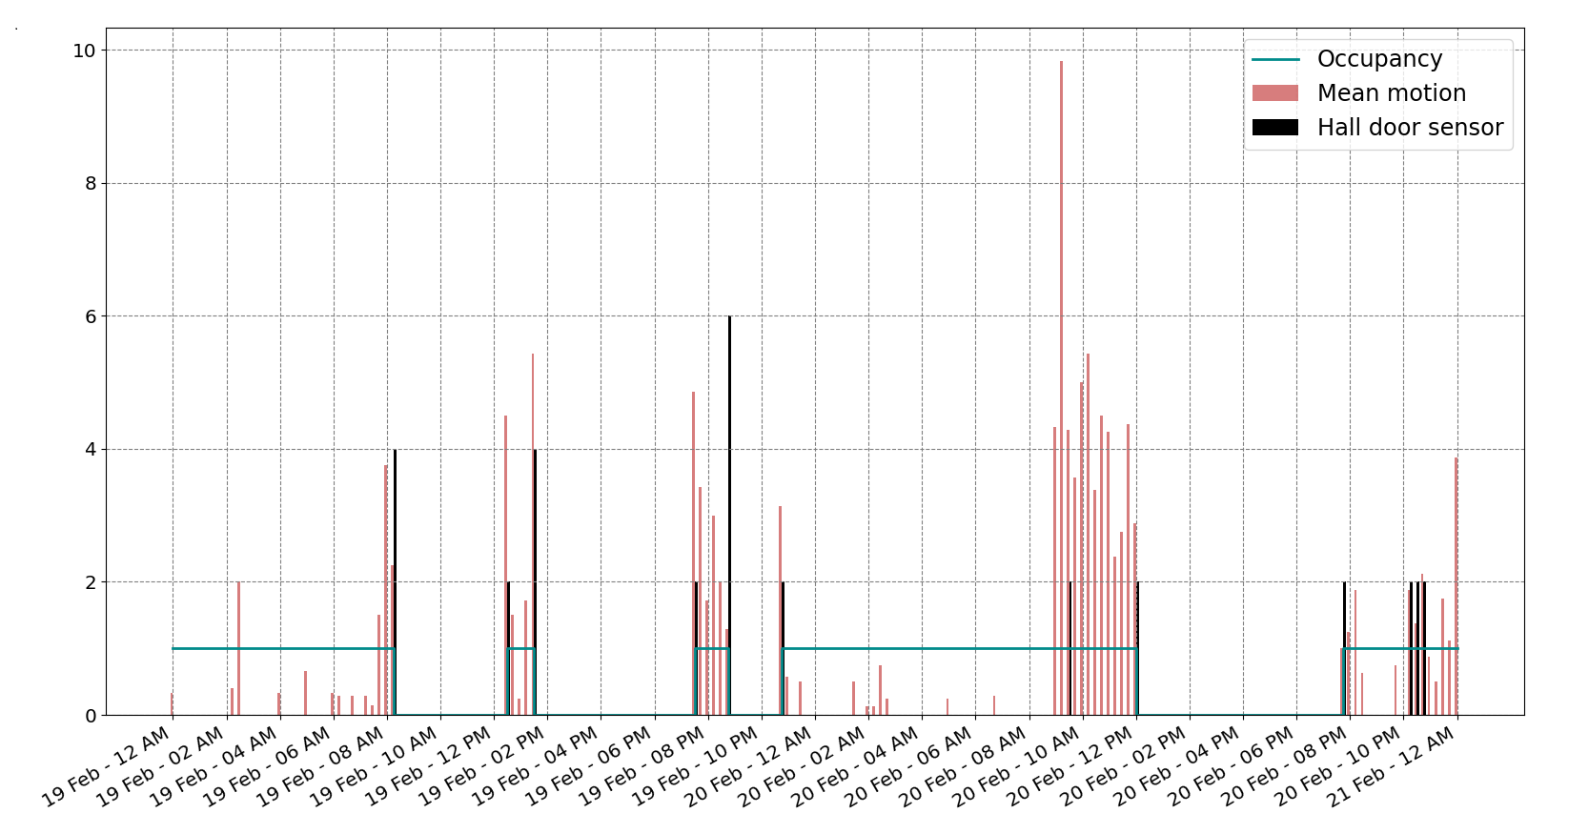
Virtual occupancy sensor - results

Slide 22
Cluster analysis of electricity consumption
Difficult to interpret multiple multi-day, week or month continuous time series
Grouping on intervals and similarity facilitates understanding
Clustering methods (K-Means, Agglomerative, Gaussian mixture…)
Where possible consumptions are grouped according to type
Heating, hot water, rest
Information from the knowledge base used to compile lists

Slide 23
Cluster analysis – heating consumption query
SELECT ?apartment ?timeseries_ref WHERE {
?apartment a inbetween:Apartment.
?apartment bot:containsElement ?radiator.
?smartplug inbetween:controlsElement ?radiator.
?smartplug bot:hasSubElement ?sensor.
?sensor a inbetween:PowerSensor.
?sensor inbetween:hasTimeSeries ?timeseries_ref
}

Slide 24
Cluster analysis – total consumptions query
SELECT ?apartment ?sensor ?subsensor ?timeseries_ref WHERE {
?apartment a inbetween:Apartment.
?sensor inbetween:metersZone ?apartment.
?sensor bot:hasSubElement ?subsensor.
?subsensor a inbetween:PowerSensor.
?subsensor inbetween:hasTimeSeries ?timeseries_ref
}

Slide 25
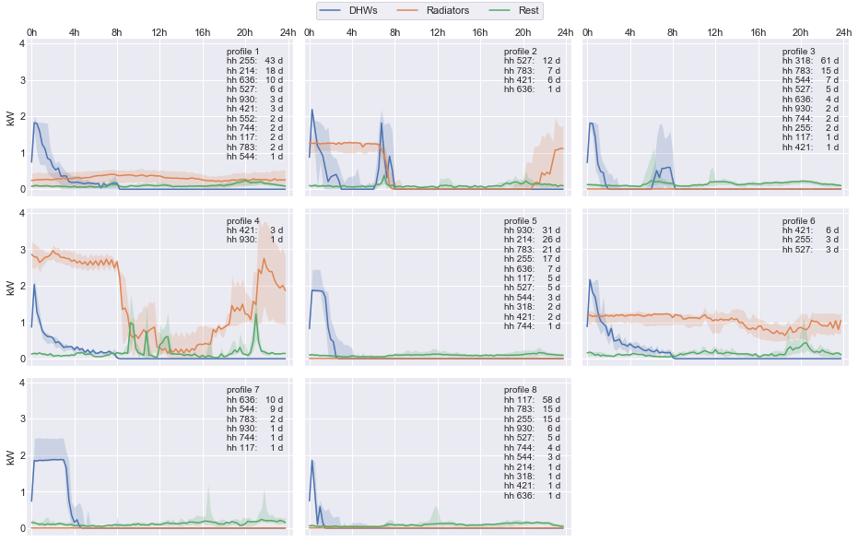
Cluster analysis ontology concerns

Slide 26
Conclusions
Resulting knowledge base was successfully used to solve problems within the project
Performance
Demonstration site changes tracking needs to be solved
Knowledge base concerns
Time series database concerns
Publishing the ontology

Slide 27
Thank you for your attention
Contact:
Milos.Sipetic@ait.ac.at

